Slide 1
Legalization of Marijuana
Dagny Knutson
CNL-527

Slide 2
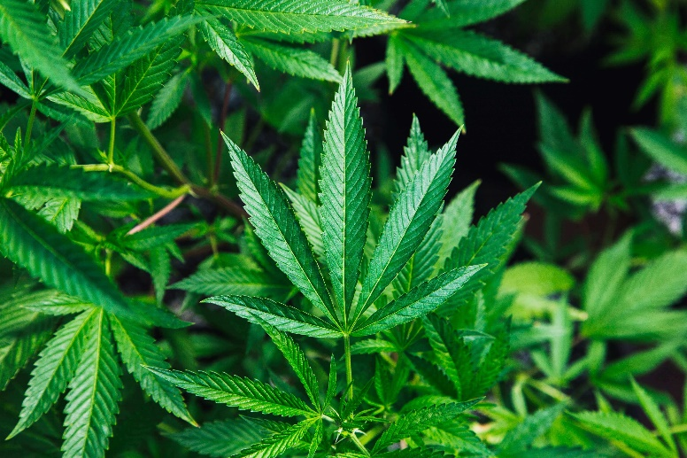
Marijuana Overview
Marijuana comes from a cannabis plant’s leaves, specifically resin. Resin produces THC – the psychoactive effect
Classification of marijuana has been difficult. It is not considered:
  A stimulant
  A sedative
  An opioid
  An hallucinogen
Notes:
Marijuana is often related to the term “cannabis” but both are different terms. Cannabis is a hemp plant that grow into tall stalks, the produces leaves in which marijuana can be made. Therefore, marijuana is made from cannabis leaves, and the resin from the leaves is what gives the drug its psychoactive properties; these psychoactive properties are called “THC,” for short (Levinthal, 2016, p. 133).
Classification of marijuana has been difficult as its properties are similar, but also unlike many other psychoactive drugs. Marijuana has excitatory effects, but is not considered a stimulant. It is sedative effects but is there is not risk of coma or death. It has mild analgesic effects but chemically related to opioids, and at high doses, it can have hallucinogen effects but is does not resemble the chemical structure of any other hallucinogens (Levinthal, 2016, p. 133). Pictured here is a cannabis leaf from cannabis plants.

Slide 3
Acute and Chronic Effects
 | Physiological Effects | Psychological Effects
 | Increased Heart Rate Fluctuation of Blood Pressure Red Eyes Increases/Suppresses Appetite Increases/Suppresses Sexual Desire | Feelings of Euphoria and Well-Being Increased awareness of Surroundings Events appear longer in duration Sleepiness Deficit in attention and memory Decreased motor skills Paranoia and anxiety
 | Tolerance Dependence and withdrawal symptoms Breathing difficulties Suppressant of body’s immune system Adversely affects reproductive system | Possible psychological dependence Continued attention and memory problems
Acute
Chronic
Notes:
Here are the acute and chronic physiological and psychological effects of smoking marijuana. In summary, marijuana does effect fine motor skills and attention similar to alcohol, but not nearly to the same extent. Likewise, marijuana has similar effects of smoking cigarettes, with a typical marijuana joint having 5x the amount of carbon monoxide as one cigarette. However, marijuana does not have direct links the risk of developing emphysema or altered lung capacity, and possibly cancer in the lungs (although more longitudinal testing should be done) (Levinthal, 2016, p. 141).

Slide 4
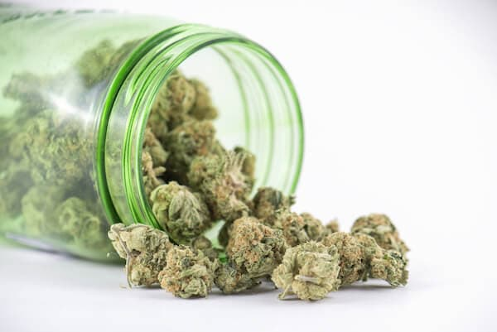
Marijuana Overview Continued
Marijuana Statistics:
Over 122 million people in the U.S. have tried marijuana
The age group of 30-49 years old makes up 51% of marijuana consumers in the U.S.
86% of US adults agree that marijuana has valid medical uses
66% of US Citizens want marijuana fully legalized
79.7% of 12th graders in 2018 say getting marijuana is very easy
(Blake, 2020)
Notes:
Here are some interesting statistics regarding marijuana use and attitudes toward marijuana. It is clear that marijuana use is very prevalent among adults, young, adults and even high school students. Marijuana generally has a positive regard amongst adults, and seen as a substance for medical use and recreational use. Currently, 15 U.S. states have legalized marijuana for recreational use in addiction to medical use, while the legality for medical use is in many states, but some limit that to just CBD oil (Blake, 2020). From here we will look at the argument for the legalization of marijuana recreationally and across the board. Pictured here is what marijuana looks like after its been taken from cannabis plants and dried.

Slide 5
Why Marijuana Should be Legalized
Marijuana is generally safer than alcohol, tobacco, and any other categorized illicit drug
Legalizing marijuana will help support criminal reform
Legalizing marijuana will benefit the economy
Notes:
Considering the information we’ve discussed thus far, the three main arguments to support the legalization of marijuana is that it is safer than any other illicit substance, in addition to alcohol and tobacco, legalizing marijuana will help support criminal reform, and legalizing marijuana recreationally will benefit and help the economy (for example, through tax revenues and job creation).

Slide 6
Marijuana is Safer (& Useful)
Does not react the same as other illicit drugs
Harm reduction strategy for opioid addiction.
Research has indicated that marijuana use may be able to help prevent other problems such as inflammation, management of stress, irritable bowel syndrome, and pain.
Notes:
The first argument is that marijuana is safer than all other illicit drug. Although there are properties of marijuana that allow user to become dependent in various ways, marijuana is not considered addictive (Levinthal, 2016). It does not do the same physical or psychological damage as illicit drugs. For example, drugs like opioids, meth, or even alcohol can lead to death if consumed too much, however, marijuana does not cause death by overdose (Levinthal, 2016). Additionally, marijuana has actually been used as a harm reduction strategy for those addicted on opioids (Roberts, 2020). Marijuana is highly used for medical purposes, but even when used recreationally, it has its benefits. Research has indicated that marijuana use may be able to help prevent other problems, such as inflammation, management of stress, and irritable bowel syndrome (Roberts, 2020).

Slide 7



Helping Criminal Justice Reform
The money spent on enforcing marijuana laws are expensive and time consuming
Halt collateral crime
Prevent disproportionate criminalization of minority communities
Notes:
Legalizing marijuana will also help adjust/change our criminal justice system for the better. First, the money spent on enforcing marijuana laws are very expensive and time consuming through policing, prosecution, and incarceration. Policing and enforcement can be focused on issues that are more ”socially significant” (Ahrens, 2020, p. 398). Second, legalizing marijuana will stop collateral crime, which occurs to protect the trade and distribution of recreational marijuana (Ahrens, 2020, p. 398). Third, legalization of marijuana will help prevent the disproportionate criminalization of minority communities. This is because policing, arrest, and enforcement of marijuana laws are typically in poor, minority communities, alluding that marijuana laws are unjust, as those in poorer and minority communities are incarcerated disproportionally for marijuana violations compared to their white counterparts (Ahrens, 2020, p. 398).

Slide 8


Helping the Economy
Legalization of Marijuana would essentially make a new industry
  - Increased tax revenue
  - Job creation
Up to 1 million new jobs by the year 2025.
Up to $105.6 billion in revenue between 2017 and 2025
Pueblo Couny, Colorado – an example that revenue can happen, even after establishing regulation over the industry.
Notes:
The legalization of marijuana would help out each state’s economy, and ultimately, the U.S. economy as whole. This is done through increased tax revenues (through business taxes and sales taxes), and also through job creation. Because legalizing marijuana would essentially open a new industry to fully operate, job openings will be plenty and taxes will be high on the new products that are in demand so that revenue can be obtained. According to a Forbes article, a study done by the cannabis analytics firm New Frontier reported that legalizing cannabis today would create over 600,000 jobs, and up to 1 million new jobs by the year 2025. Additionally, the report stated that the legalization of marijuana federally could result in revenues of up to $105.6 billion between the years 2017 and 2025 (Zhang, 2018). Some may argue that the cost for regulation of the industry alone could diminish revenue, however the economy of Pueblo County, Colorado is an example of how appropriate regulation and selling of marijuana still gave them a net revenue.

Slide 9
Recommendations
Laws for legalization and enforcement for 21 and older
Thorough, but appropriate regulations over the industry
Notes:
In conclusion, legalization of marijuana would be safe with proper regulation (because it is not like other illicit drugs), it would help support criminal justice reform, and it would help the economy. A few other recommendations for the safe legalization of marijuana includes ensuring that the law of legality is for adults 21 and older and ensuring property regulation of the industry is in place. This is to help combat any increase use of marijuana for developing adolescents/minors, and also ensure that the marijuana being distributed is safe for the public.

Slide 10
References
Ahrens, D. (2020). Retroactive legality: Marijuana convictions and restorative justice in an era of criminal justice reform. The Journal of Criminal Law and Criminology, 110(3), p. 379-428. Retrieved from https://lopes.idm.oclc.org/login?url=https://search.ebscohost.com/login.aspx?direct=true&db=ofs&AN=143604591&site=eds-live&scope=site
Blake, D. (2020). Marijuana statistics 2020, usage, trends, and data. American Marijuana. Retrieved from https://americanmarijuana.org/marijuana-statistics/
Roberts, J. (2020). Medical Cannabis in Adult Mental Health Settings: Reconstructing One of the Most Maligned Medications in the United States. Clinical Social Work Journal, 48(4), 412–420. Retrieved from https://lopes.idm.oclc.org/login?url=https://search.ebscohost.com/login.aspx?direct=true&db=ofs&AN=146432063&site=eds-live&scope=site
Levinthal, C. (2016). Drugs, behavior, and modern society (8th ed.). Pearson.
Zheng, M. (2018). Legal marijuana is a boom to the economy, finds study. Forbes. Retrieved from https://www.forbes.com/sites/monazhang/2018/03/13/legal-marijuana-is-a-boon-to-the-economy-finds-study/?sh=2b6f4ff5ee9d

